Slide 1
ELNG 304- POWER ELECTRONICS
DC/DC Converter –II
Department of Computer & Electrical Engineering
School of Engineering
2023/2024 Academic Year

Slide 2
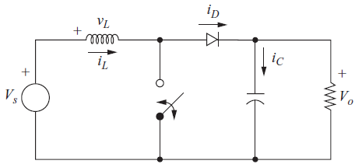
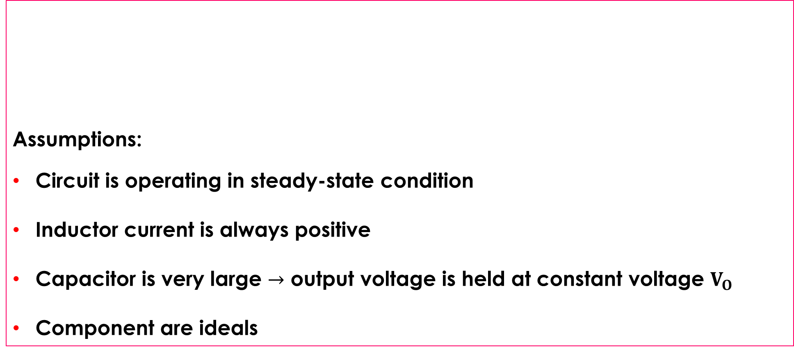
THE BOOST/STEP-UP CONVERTER
Assumptions:
Circuit is operating in steady-state condition
Inductor current is always positive
Capacitor is very large $→$ output voltage is held at constant voltage $V_{O}$
Component are ideals

Slide 3
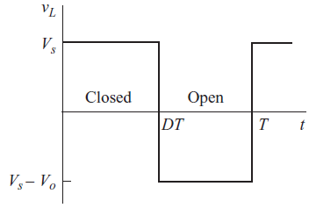
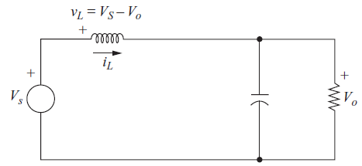
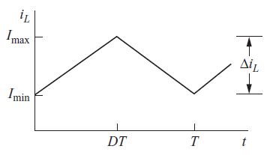
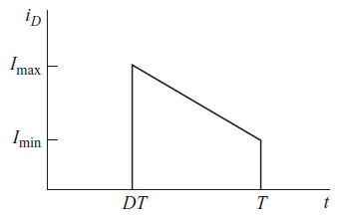
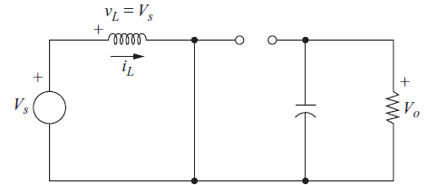
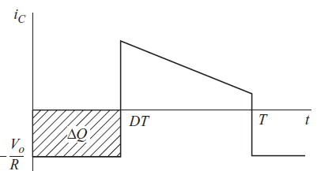

BOOST CONVERTER ANALYSIS
When switch is CLOSED : Diode is R.B
Positive voltage across L, $V_{L}$=$V_{s}$-$V_{o}$
When switch is OPEN: Diode is F.B
$i_{L}$ continues to flow energy stored in L
$V_{L}$ = $V_{S}$

Slide 4

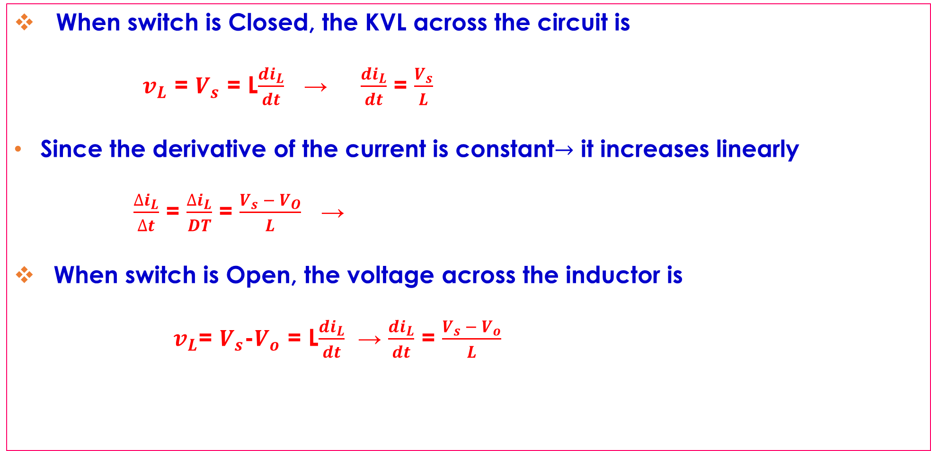
BOOST CONVERTER
When switch is Closed, the KVL across the circuit is
$v_{L}$ = $V_{s}$ = L$\frac{{di}_{L}}{dt}$ → $\frac{{di}_{L}}{dt}$ = $\frac{V_{s}}{L}$
Since the derivative of the current is constant$→$ it increases linearly
$\frac{{∆i}_{L}}{∆t}$ = $\frac{{∆i}_{L}}{DT}$ = $\frac{V_{s} − V_{O}}{L}$ →
When switch is Open, the voltage across the inductor is
$v_{L}$= $V_{s}$-$V_{o}$ = L$\frac{{di}_{L}}{dt}$ → $\frac{{di}_{L}}{dt}$ = $\frac{V_{s} − V_{o}}{L}$
${\left({∆i}_{L}\right)}_{closed}$ = $\frac{V_{s}DT}{L}$

Slide 5

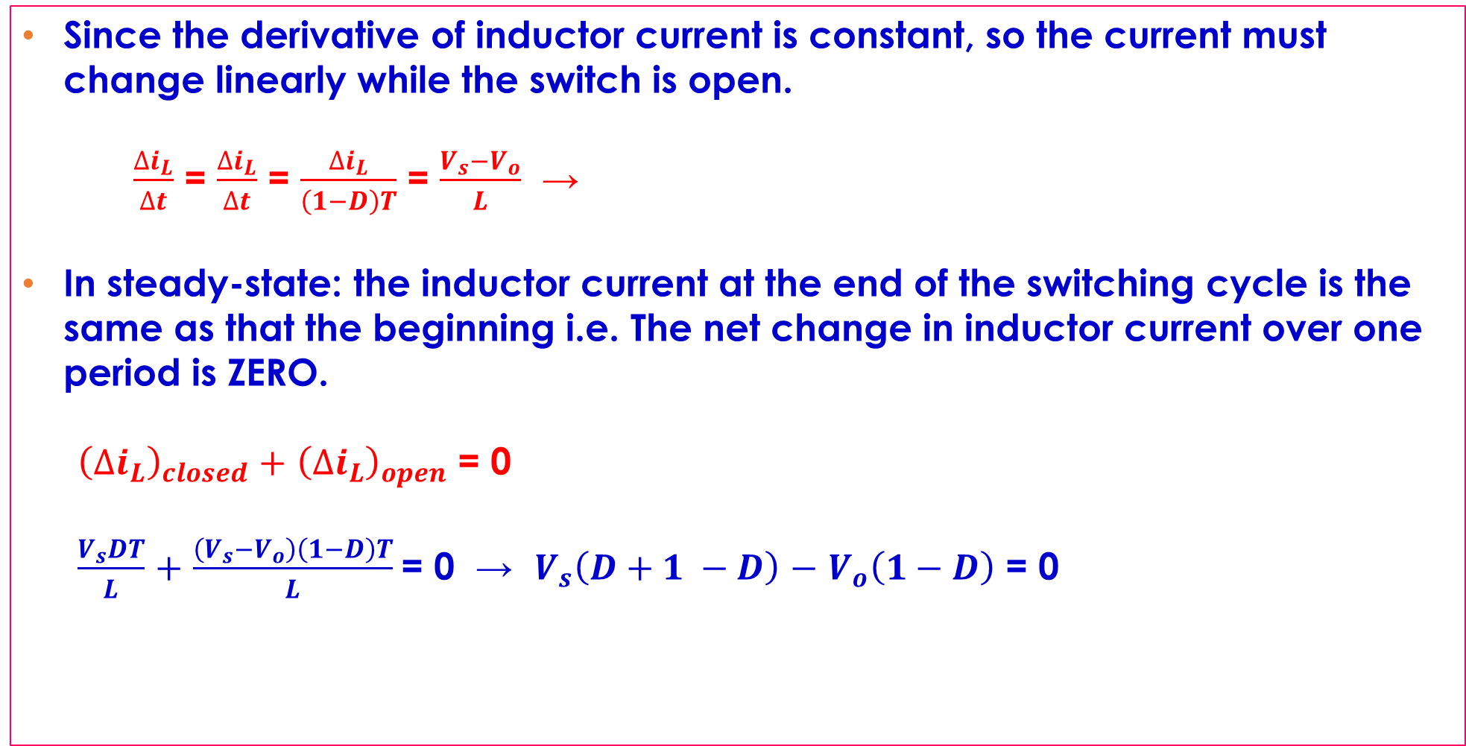

BOOST CONVERTER
Since the derivative of inductor current is constant, so the current must change linearly while the switch is open.
$\frac{{∆i}_{L}}{∆t}$ = $\frac{{∆i}_{L}}{∆t}$ = $\frac{{∆i}_{L}}{\left(1−D\right)T}$ = $\frac{V_{s}−V_{o}}{L}$ →
In steady-state: the inductor current at the end of the switching cycle is the same as that the beginning i.e. The net change in inductor current over one period is ZERO.
${\left({∆i}_{L}\right)}_{closed}$ $+$ ${\left({∆i}_{L}\right)}_{open}$ = 0
$\frac{V_{s}DT}{L}$ $+$ $\frac{\left(V_{s}−V_{o}\right)\left(1−D\right)T}{L}$= 0 → $V_{s}\left(D+1 −D\right)$ $−$ $V_{o}\left(1−D\right)$ = 0
${\left({∆i}_{L}\right)}_{open}$ = $\frac{\left(V_{s} − V_{o}\right)\left(1−D\right)T}{L}$
$$V_{o}= \frac{V_{s}}{1 −D}$$

Slide 6
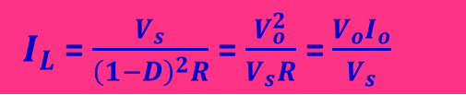
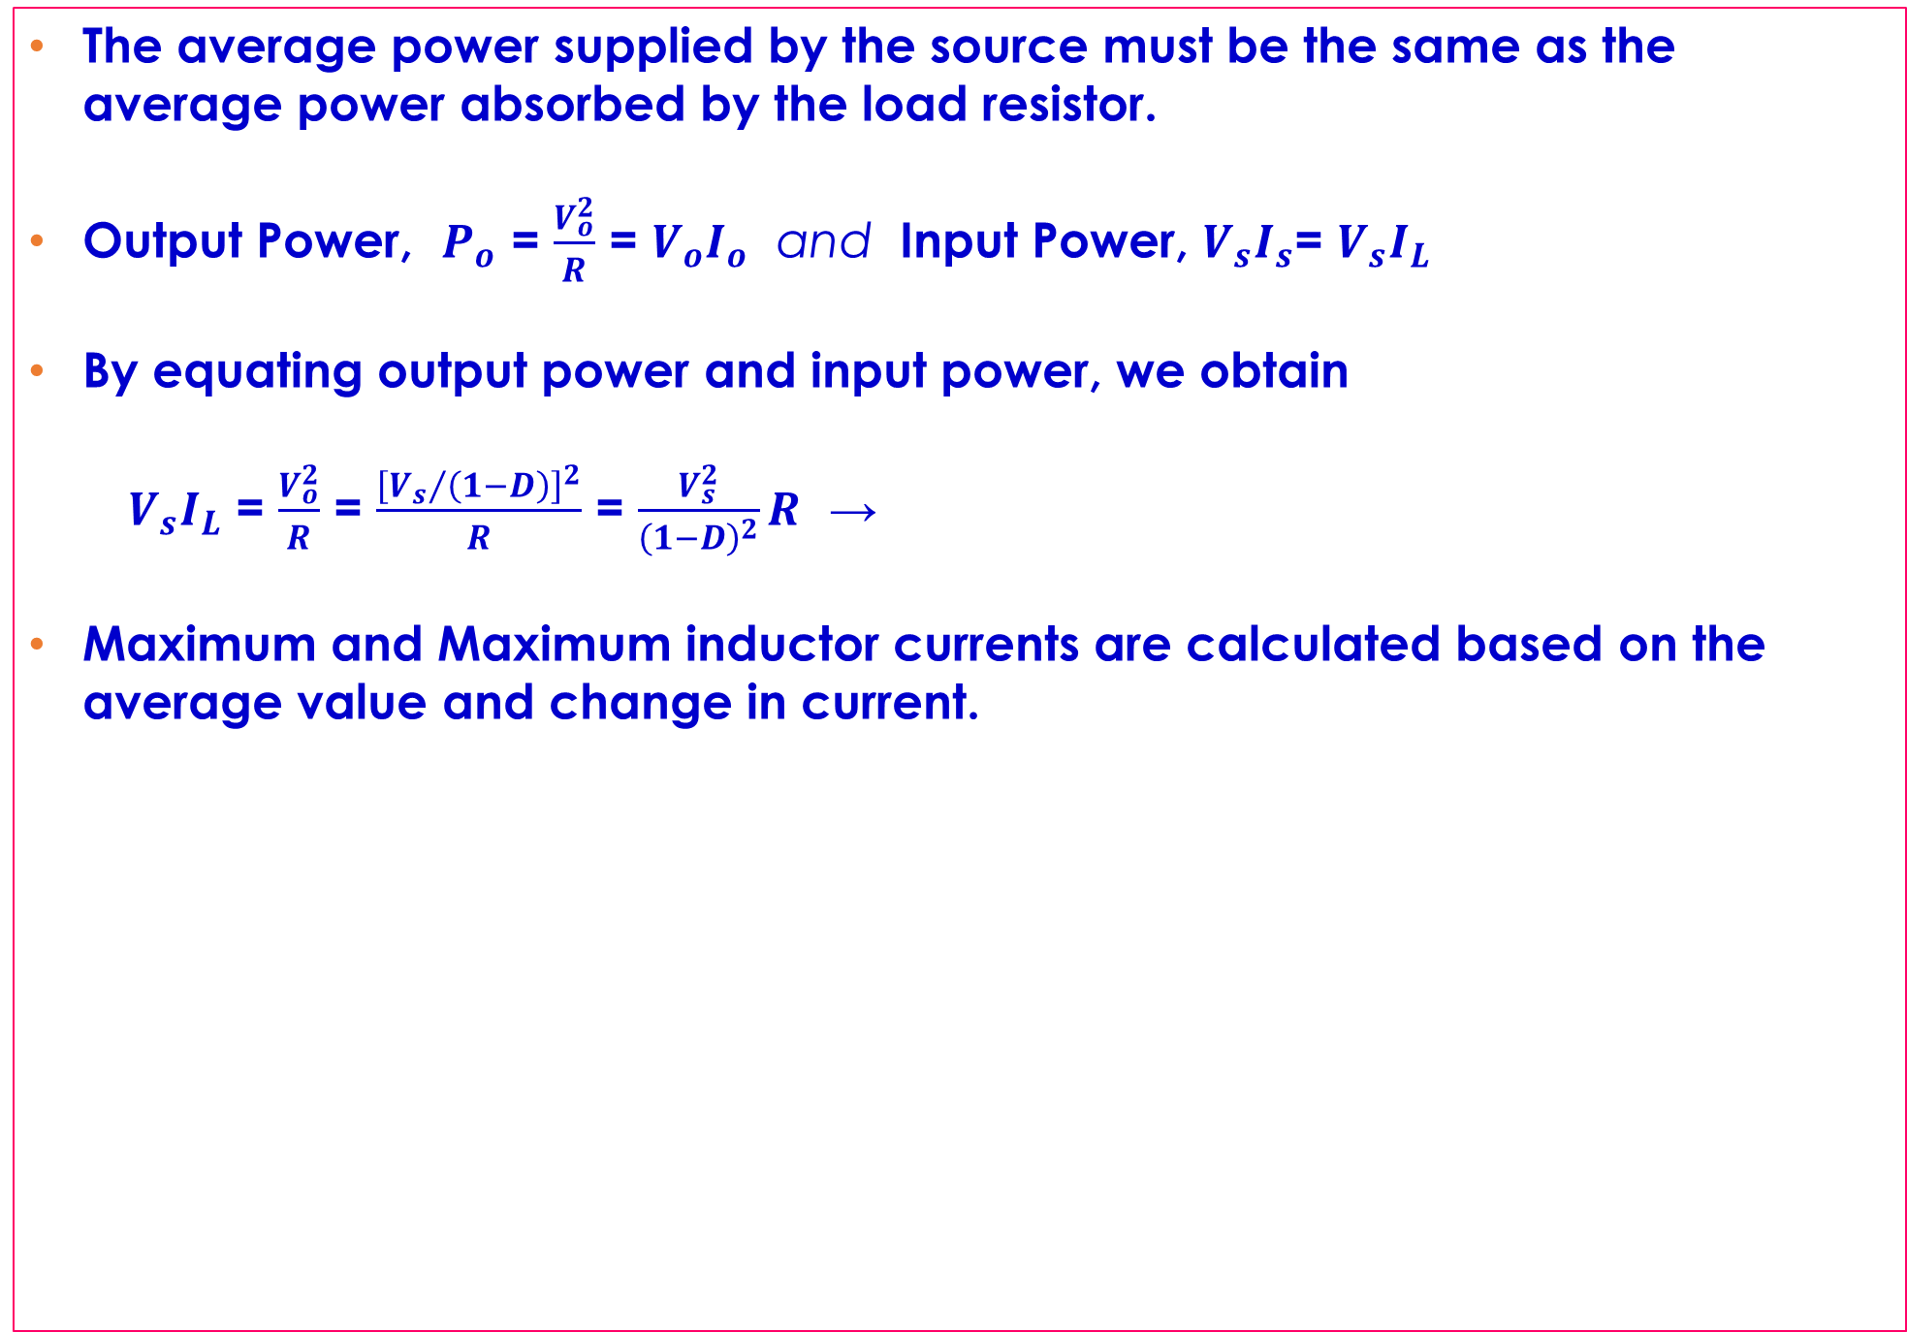


BOOST CONVERTER
The average power supplied by the source must be the same as the average power absorbed by the load resistor.
Output Power, $P_{o}$ = $\frac{V_{o}^{2}}{R}$ = $V_{o}I_{o}$ and Input Power, $V_{s}I_{s}$= $V_{s}I_{L}$
By equating output power and input power, we obtain
$V_{s}I_{L}$ = $\frac{V_{o}^{2}}{R}$ = $\frac{{\left[{V_{s}}/{\left(1−D\right)}\right]}^{2}}{R}$ = $\frac{V_{s}^{2}}{{\left(1−D\right)}^{2}}R$ →
Maximum and Maximum inductor currents are calculated based on the average value and change in current.
$I_{L}$ = $\frac{V_{s}}{{\left(1−D\right)}^{2}R}$ = $\frac{V_{o}^{2}}{V_{s}R}$ = $\frac{V_{o}I_{o}}{V_{s}}$
$I_{max}=$ $I_{L}+$ $\frac{{∆i}_{L}}{2}$ = $\frac{V_{s}}{{\left(1−D\right)}^{2}R}$ $+$ $\frac{V_{s}DT}{2L}$
$I_{min}$ = $I_{L}−$ $\frac{{∆i}_{L}}{2}$ = $\frac{V_{s}}{{\left(1−D\right)}^{2}R}$ - $\frac{V_{s}DT}{2L}$

Slide 7

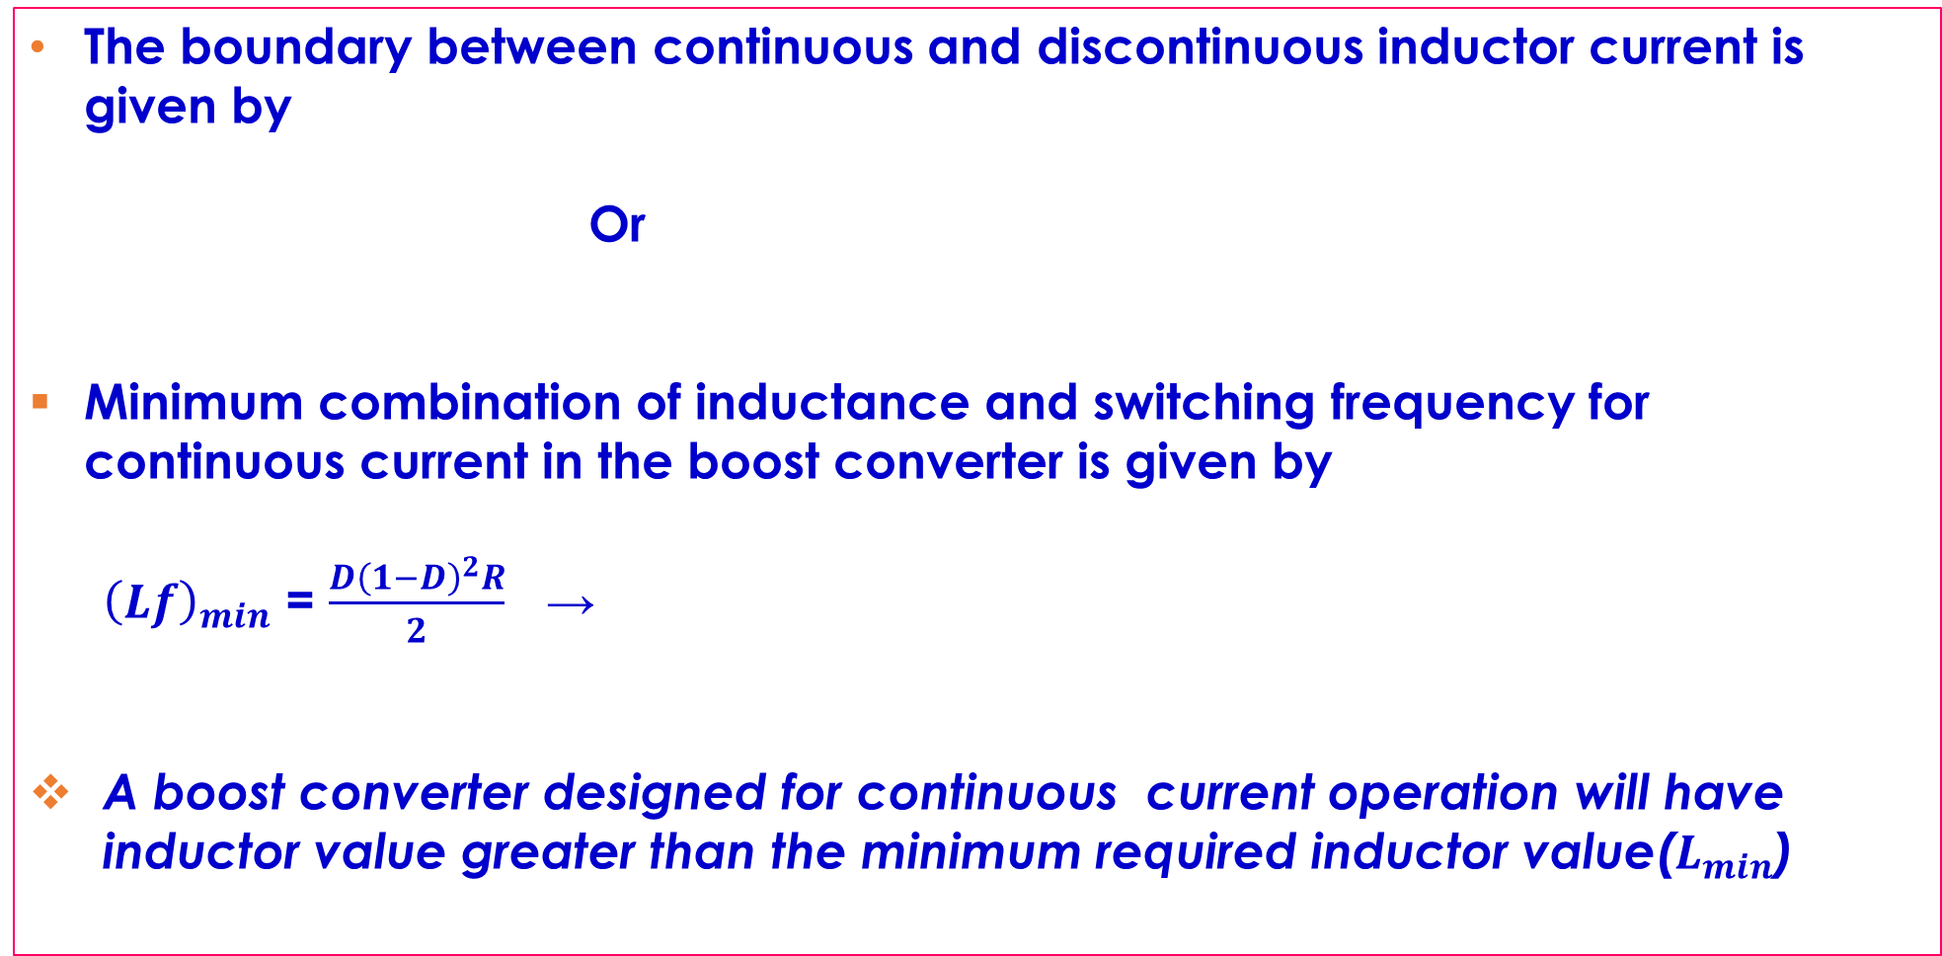


BOOST CONVERTER
The boundary between continuous and discontinuous inductor current is given by
Or
Minimum combination of inductance and switching frequency for continuous current in the boost converter is given by
${\left(Lf\right)}_{min}$ = $\frac{D{\left(1−D\right)}^{2}R}{2}$ →
A boost converter designed for continuous current operation will have inductor value greater than the minimum required inductor value($L_{min}$)
$I_{min}$ = 0 = $\frac{V_{s}}{{\left(1−D\right)}^{2}R}$ $−$ $\frac{V_{s}DT}{2L}$
$\frac{V_{s}}{{\left(1−D\right)}^{2}R}$ = $\frac{V_{s}DT}{2L}$ = $\frac{V_{s}D}{2Lf}$
$L_{min}$ = $\frac{D{\left(1−D\right)}^{2}R}{2f}$

Slide 8

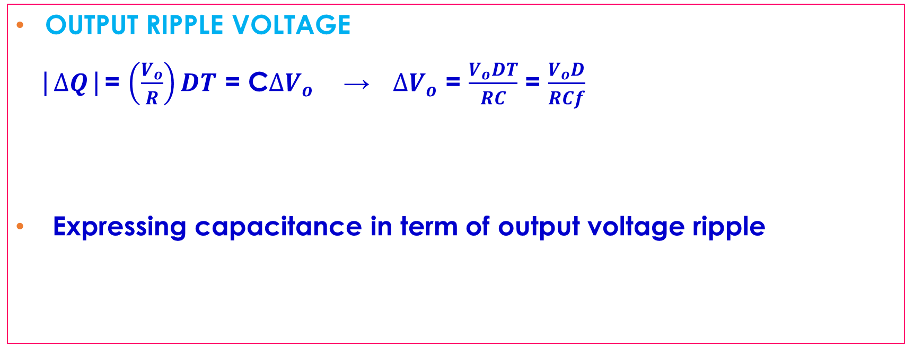
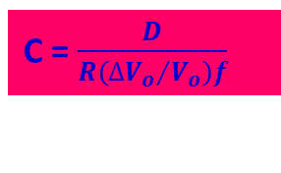
BOOST CONVERTER
OUTPUT RIPPLE VOLTAGE
|$∆Q$|= $\left(\frac{V_{o}}{R}\right)DT$ = C$∆V_{o}$ → $∆V_{o}$ = $\frac{V_{o}DT}{RC}$ = $\frac{V_{o}D}{RCf}$
Expressing capacitance in term of output voltage ripple
$\frac{∆V_{o}}{V_{o}}$ = $\frac{D}{RCf}$
C = $\frac{D}{R\left({{∆V}_{o}}/{V_{o}}\right)f}$

Slide 9
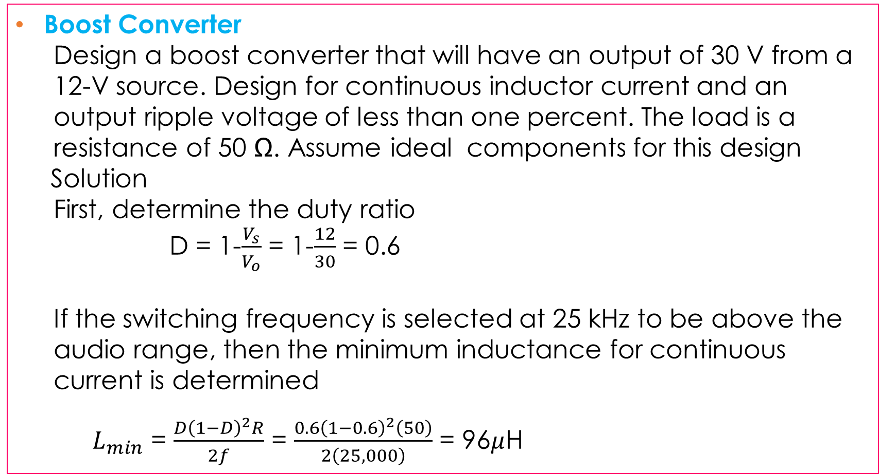
BOOST CONVERTER
Boost Converter
Design a boost converter that will have an output of 30 V from a 12-V source. Design for continuous inductor current and an output ripple voltage of less than one percent. The load is a resistance of 50 Ω. Assume ideal components for this design
Solution
First, determine the duty ratio
D = 1-$\frac{V_{s}}{V_{o}}$ = 1-$\frac{12}{30}$ = 0.6
If the switching frequency is selected at 25 kHz to be above the audio range, then the minimum inductance for continuous current is determined
$L_{min}$ = $\frac{D{\left(1−D\right)}^{2}R}{2f}$ = $\frac{0.6{\left(1−0.6\right)}^{2}\left(50\right)}{2\left(25,000\right)}$ = 96$μ$H

Slide 10
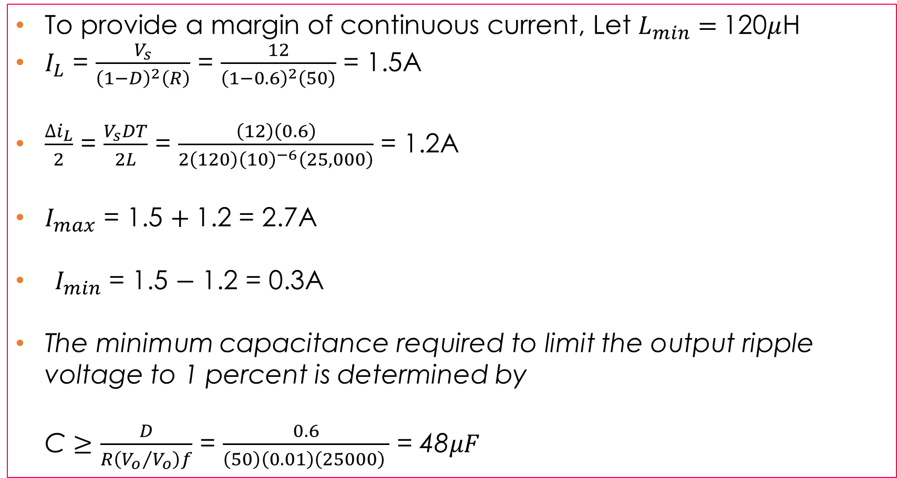
BOOST CONVERTER
To provide a margin of continuous current, Let $L_{min}=$120$μ$H
$I_{L}$ = $\frac{V_{s}}{{\left(1−D\right)}^{2}\left(R\right)}$ = $\frac{12}{{\left(1−0.6\right)}^{2}\left(50\right)}$ = 1.5A
$\frac{∆i_{L}}{2}$ = $\frac{V_{s}DT}{2L}$ = $\frac{\left(12\right)\left(0.6\right)}{2\left(120\right){\left(10\right)}^{−6}\left(25,000\right)}$ = 1.2A
$I_{max}$ = 1.5 $+$1.2 = 2.7A
$I_{min}$ = 1.5 $−$ 1.2 = 0.3A
The minimum capacitance required to limit the output ripple voltage to 1 percent is determined by
C $≥$ $\frac{D}{R\left({V_{o}}/{V_{o}}\right)f}$ = $\frac{0.6}{\left(50\right)\left(0.01\right)\left(25000\right) }$ = 48$μF$

Slide 11
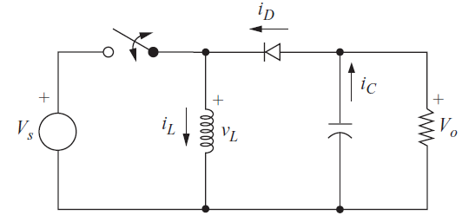
BUCK-BOOST CONVERTER
Assumptions:
Circuit is operating in the steady-state condition
The inductor current is continuous
The capacitor is large enough to assume a constant output voltage.
The switch is closed for time DT and open for (1-D)T

Slide 12
BUCK-BOOST CONVERTER
Assumptions:
Circuit is operating in the steady-state condition
The inductor current is continuous
The capacitor is large enough to assume a constant output voltage.
The switch is closed for time DT and open for (1-D)T

Slide 13
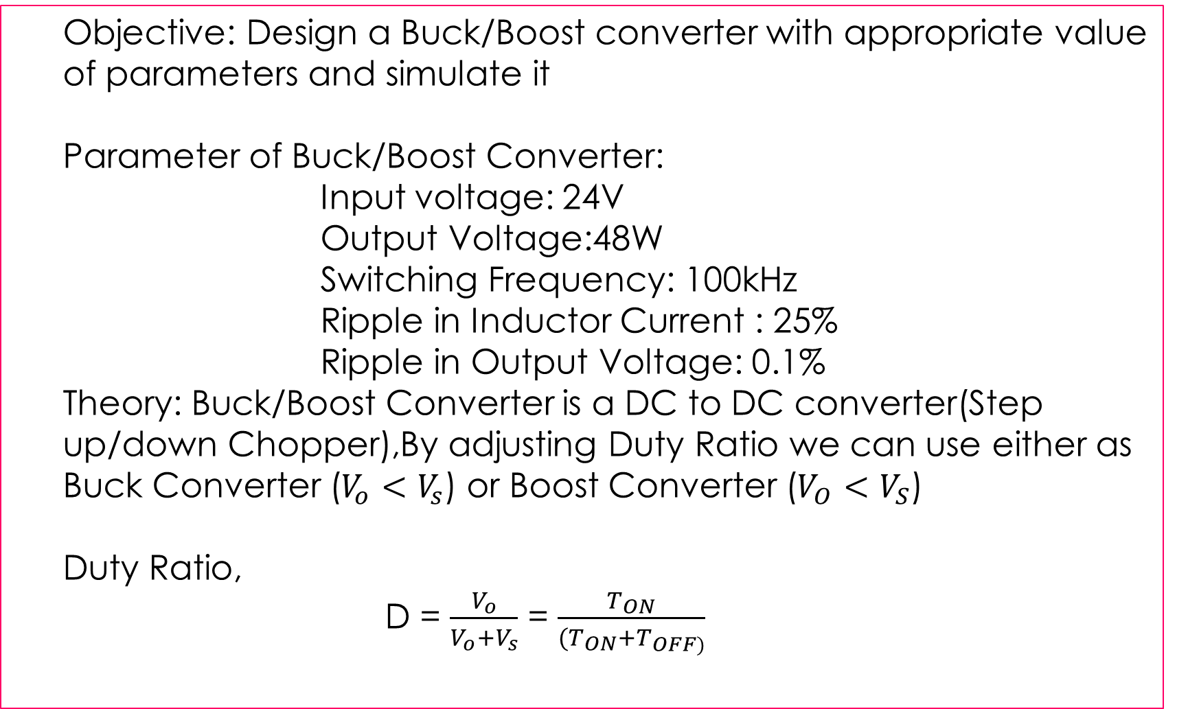
ASSIGNMENT
  Objective: Design a Buck/Boost converter with appropriate value of parameters and simulate it
  Parameter of Buck/Boost Converter:
  Input voltage: 24V
  Output Voltage:48W
  Switching Frequency: 100kHz
  Ripple in Inductor Current : 25%
  Ripple in Output Voltage: 0.1%
  Theory: Buck/Boost Converter is a DC to DC converter(Step up/down Chopper),By adjusting Duty Ratio we can use either as Buck Converter ($V_{o}$ $<$ $V_{s}$) or Boost Converter ($V_{O}$ $<$ $V_{S}$)
  Duty Ratio,
  D = $\frac{V_{o}}{V_{o}+V_{s}}$ = $\frac{T_{ON}}{(T_{ON}+T_{OFF)}}$

Slide 14



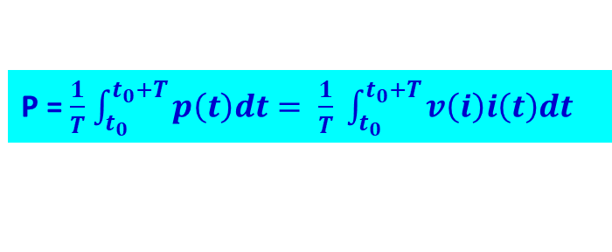
POWER COMPUTATION
Instantaneous Power
(a) (b)
Average Power
where T is the period of the power waveform
$p(t)$ = $v\left(t\right)i(t)$
P = $\frac{1}{T}$ $\int_{t_{0}}^{t_{0}+T}{p\left(t\right)dt}= \frac{1}{T} \int_{t_{0}}^{t_{0}+T}{v\left(i\right)i\left(t\right)dt}$
Notes:
Instantaneous power is generally a time-varying quantity. If the passive sign convention illustrated in (a) is observed, the device is absorbing power if p(t) is positive at a specified value of time t. The device is supplying power if p(t) is negative. Source frequently have an assumed current direction consistent with supplying power.

Slide 15
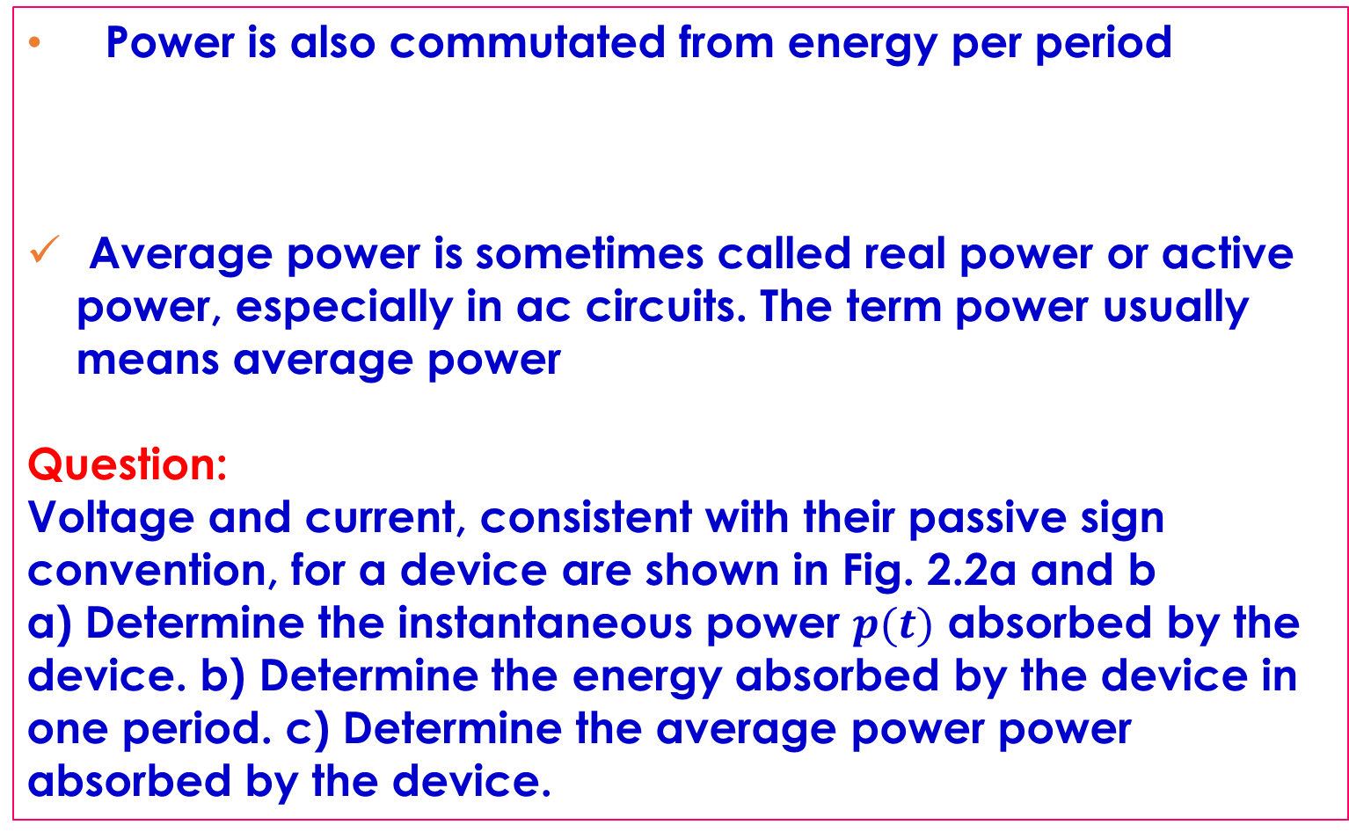

POWER COMPUTATION
Power is also commutated from energy per period
Average power is sometimes called real power or active power, especially in ac circuits. The term power usually means average power
Question:
Voltage and current, consistent with their passive sign convention, for a device are shown in Fig. 2.2a and b
a) Determine the instantaneous power $p(t)$ absorbed by the device. b) Determine the energy absorbed by the device in one period. c) Determine the average power power absorbed by the device.
P = $\frac{W}{T}$

Slide 16
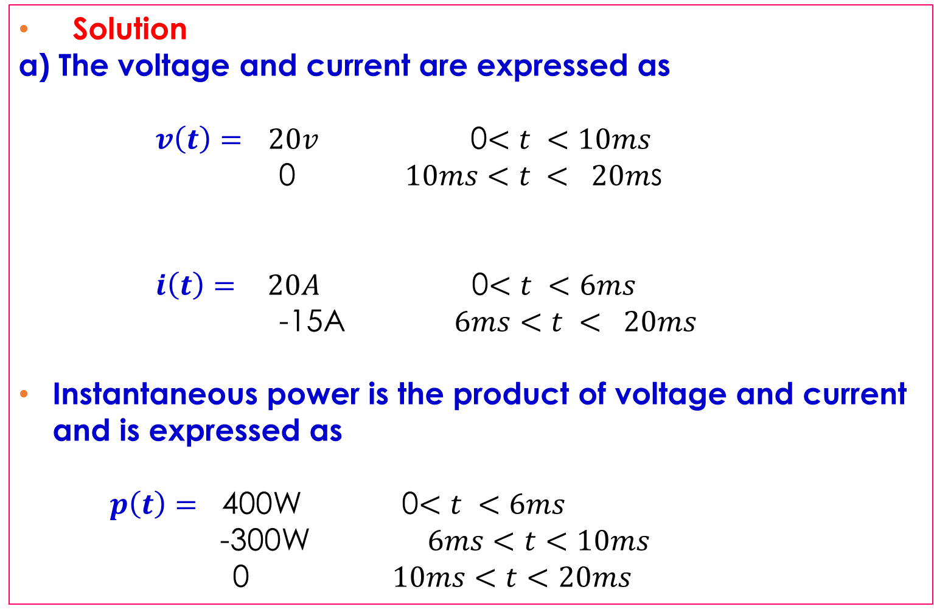
POWER COMPUTATION
Solution
a) The voltage and current are expressed as
$v\left(t\right)=$ $20v$ 0$<t <10ms$
0 $10ms<t < 20m$s
$i\left(t\right)=$ $20A$ 0$<t <6ms$
-15A $6ms<t < 20ms$
Instantaneous power is the product of voltage and current and is expressed as
$p\left(t\right)=$ 400W 0$<t <6ms$
-300W $6ms<t<10ms$
0 $10ms<t<20ms$

Slide 17


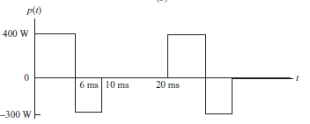

POWER COMPUTATION
Solution
$(b)$ Energy absorbed by the device in one period is expressed as
W = $\int_{0}^{T}{P\left(t\right)dt= \int_{0}^{0.006}{400dt + \int_{0.006}^{0.010}{−300dt+\int_{0.010}^{0,020}{0dt}=2.4−1.2 }}}$= 1.2 J
(a)
(b)
(c)

Slide 18
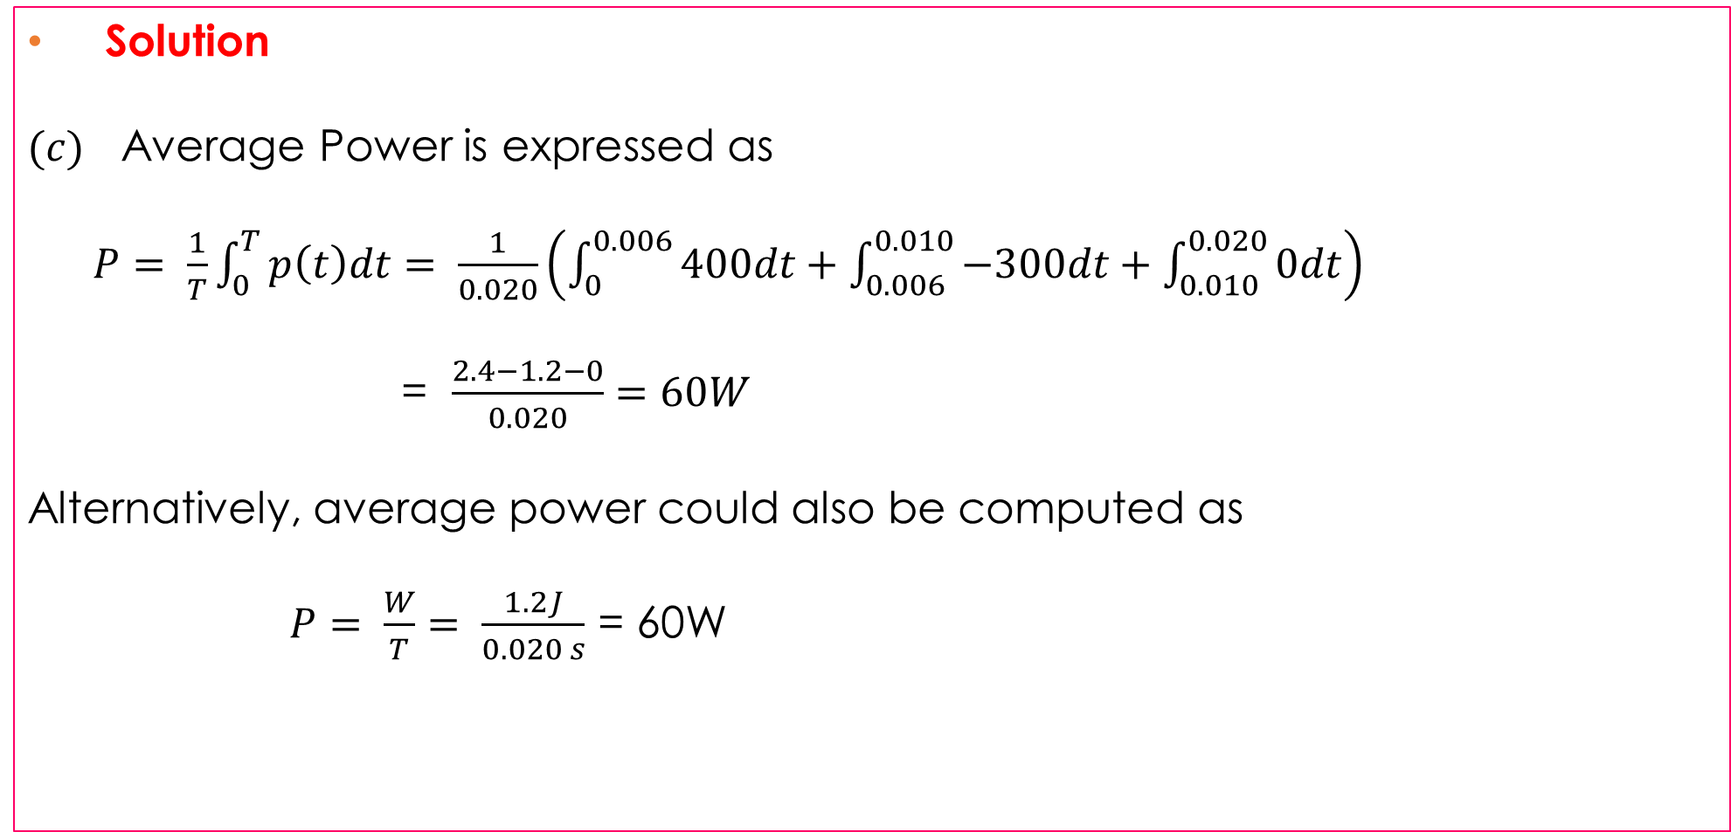
POWER COMPUTATION
Solution
$(c)$ Average Power is expressed as
$P= \frac{1}{T}\int_{0}^{T}{p\left(t\right)dt= \frac{1}{0.020}}\left(\int_{0}^{0.006}{400dt+\int_{0.006}^{0.010}{−300dt+\int_{0.010}^{0.020}{0dt}}}\right)$
= $\frac{2.4−1.2−0}{0.020}=60W$
Alternatively, average power could also be computed as
$P= \frac{W}{T}= \frac{1.2J}{0.020 s}$ = 60W

Slide 19
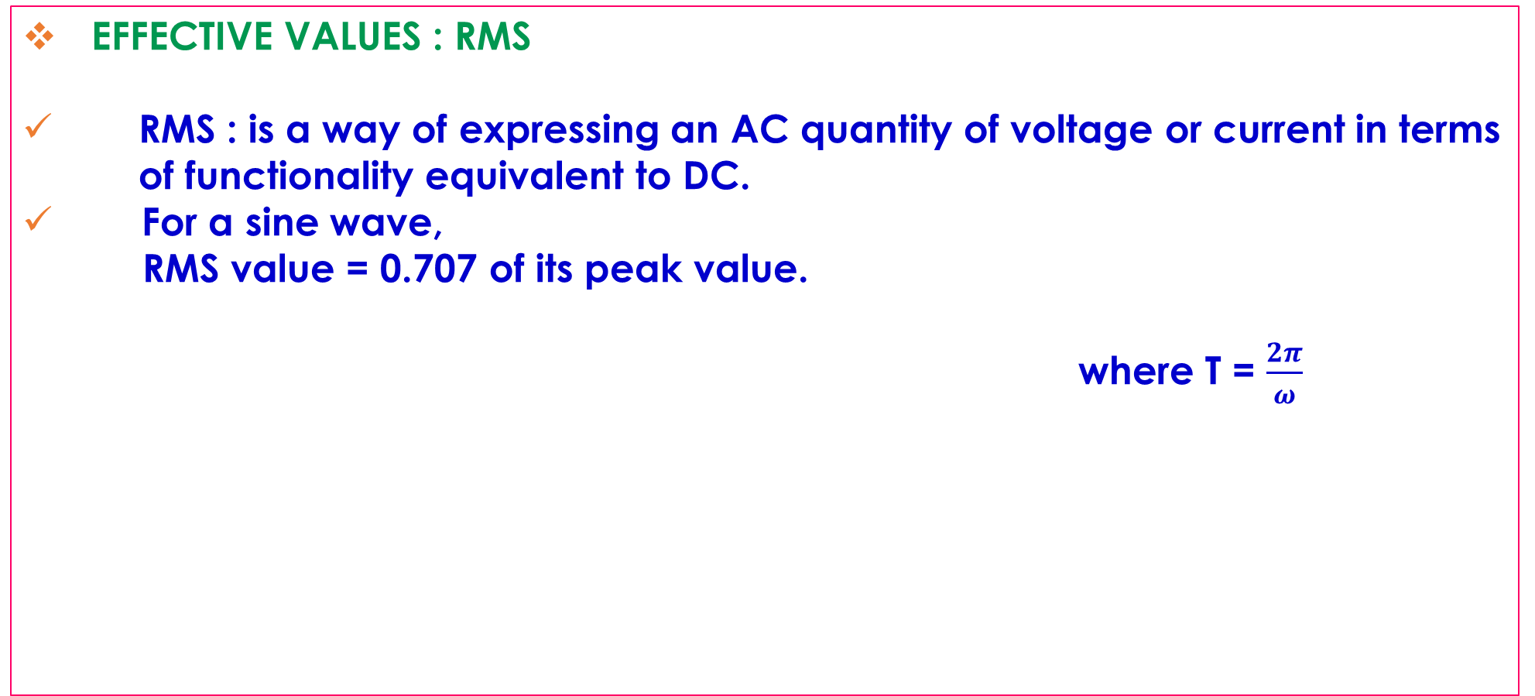
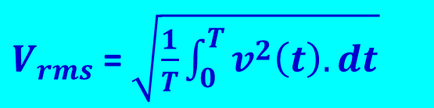
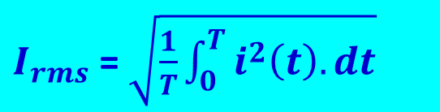
POWER COMPUTATION
EFFECTIVE VALUES : RMS
RMS : is a way of expressing an AC quantity of voltage or current in terms of functionality equivalent to DC.
For a sine wave,
RMS value = 0.707 of its peak value.
where T = $\frac{2π}{ω}$
$V_{rms}$ = $\sqrt{\frac{1}{T}\int_{0}^{T}{v^{2}\left(t\right).dt}}$
$I_{rms}$ = $\sqrt{\frac{1}{T}\int_{0}^{T}{i^{2}\left(t\right).dt}}$

Slide 20
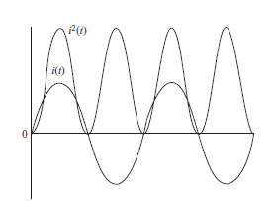
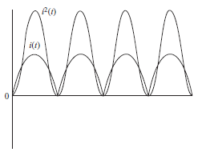
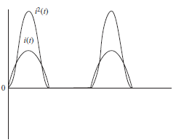
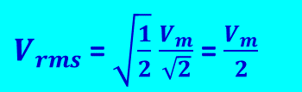
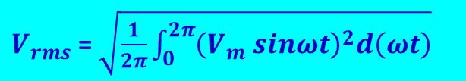
POWER COMPUTATION
SINE WAVE
$V_{rms}$ = $\sqrt{\frac{1}{2π}\int_{0}^{2π}{{\left(V_{m} sinωt\right)}^{2}d\left(ωt\right)}}$
(a) Sine Wave
(b) Full-wave rectified sine wave
$V_{rms}$ = $\sqrt{\frac{1}{2}}$ $\frac{V_{m}}{\sqrt{2}}$ = $\frac{V_{m}}{2}$
(c) Half-wave rectified sine wave

Slide 21
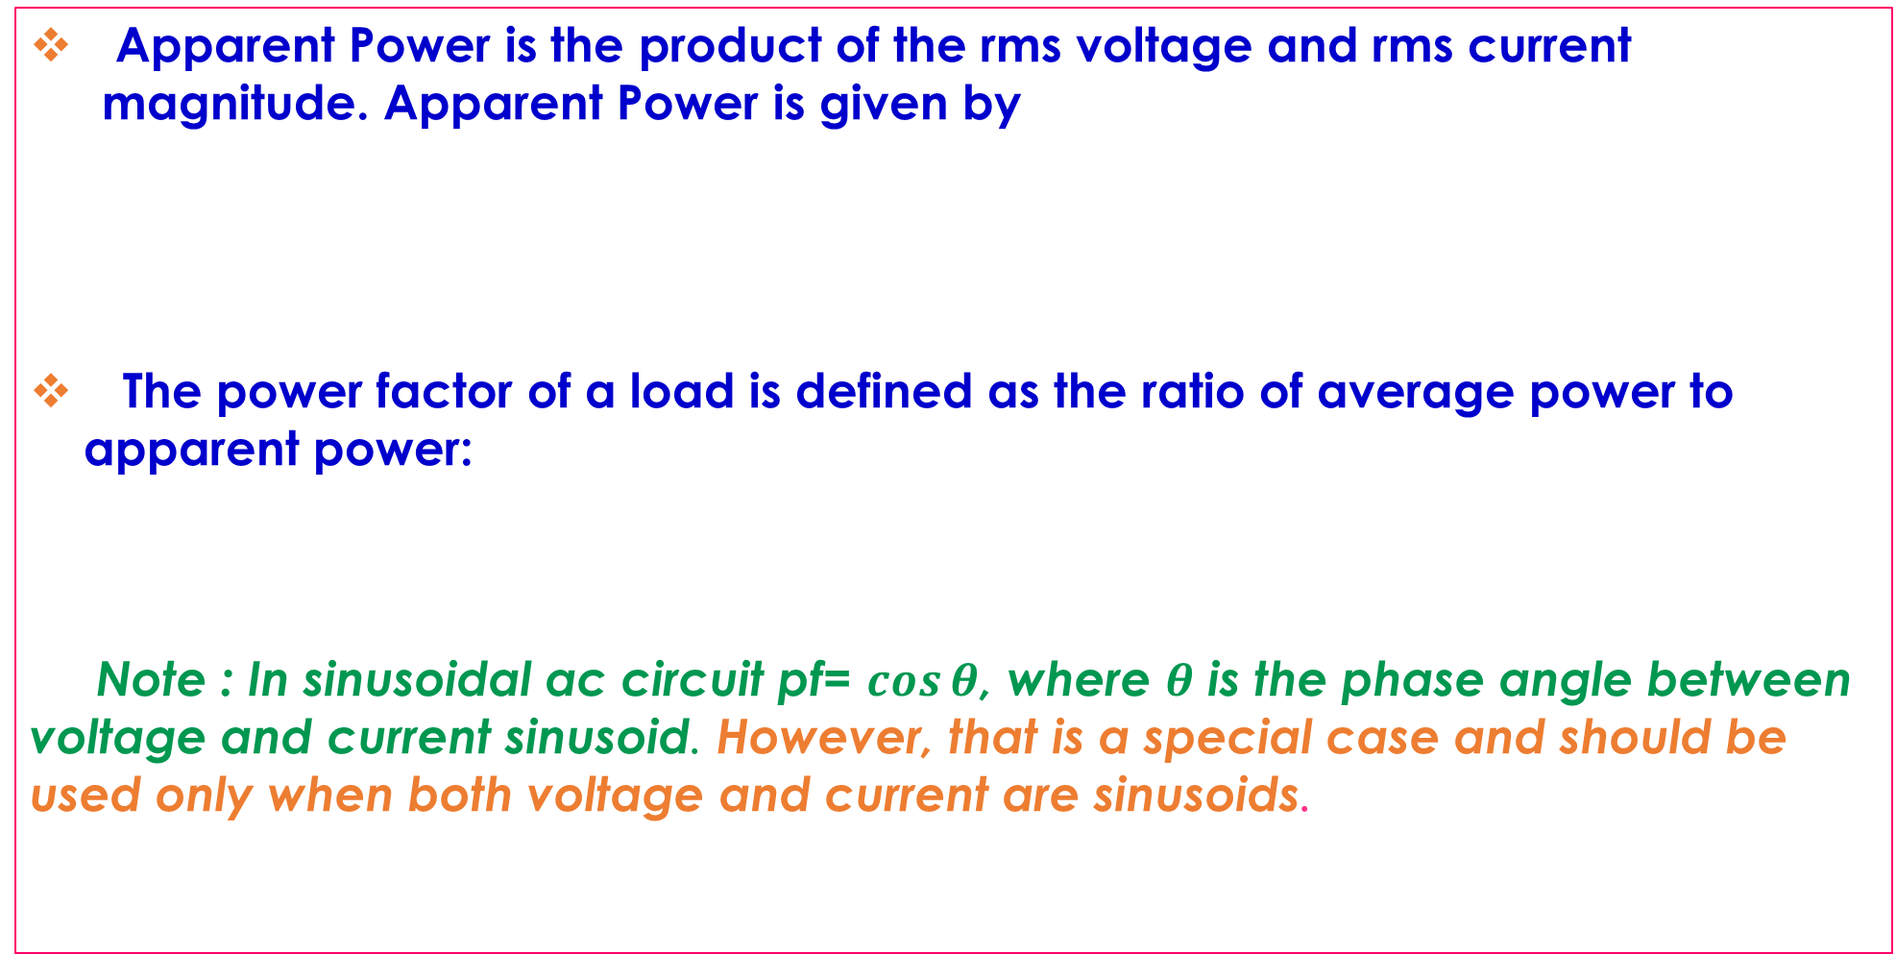


APPARENT POWER AND POWER FACTOR
Apparent Power is the product of the rms voltage and rms current magnitude. Apparent Power is given by
The power factor of a load is defined as the ratio of average power to apparent power:
Note : In sinusoidal ac circuit pf= $\cos{θ}$, where $θ$ is the phase angle between voltage and current sinusoid. However, that is a special case and should be used only when both voltage and current are sinusoids.
S = $V_{rms}I_{rms}$
pf = $\frac{P}{S}$ = $\frac{P}{V_{rms}I_{rms}}$

Slide 22
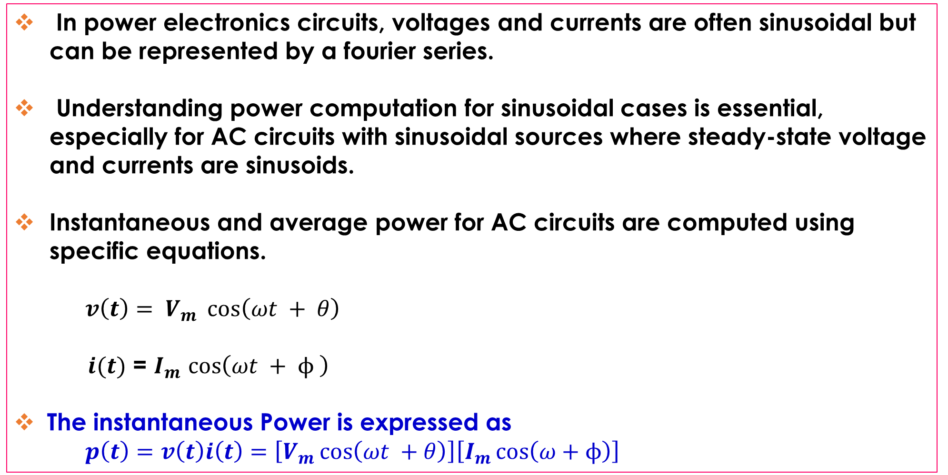
POWER COMPUTATION FOR SINUSOIDAL AC CIRCUIT
In power electronics circuits, voltages and currents are often sinusoidal but can be represented by a fourier series.
Understanding power computation for sinusoidal cases is essential, especially for AC circuits with sinusoidal sources where steady-state voltage and currents are sinusoids.
Instantaneous and average power for AC circuits are computed using specific equations.
$v\left(t\right)= V_{m} \cos\left(ωt + θ\right)$
$i(t)$ = $I_{m}$ $\cos\left(ωt + ϕ \right)$
The instantaneous Power is expressed as
$p\left(t\right)=v\left(t\right)i\left(t\right)=\left[V_{m}\cos\left(ωt +θ\right)\right]\left[I_{m}\cos\left(ω+ϕ\right)\right]$

Slide 23
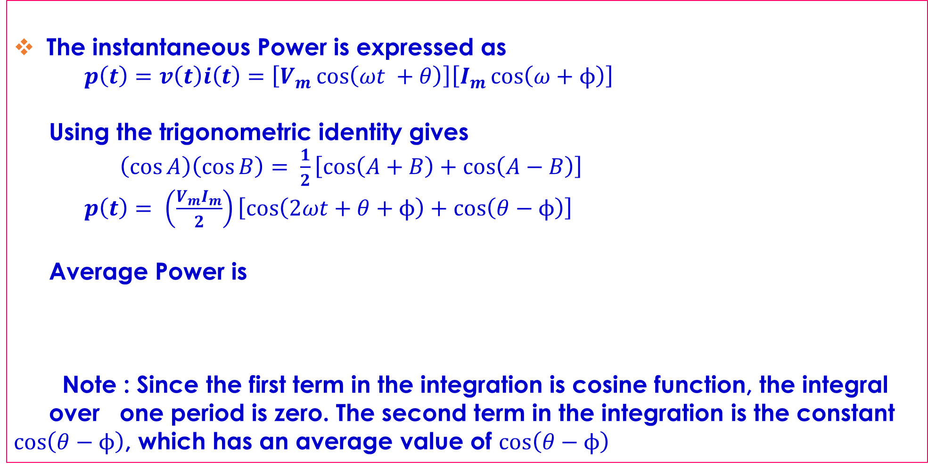
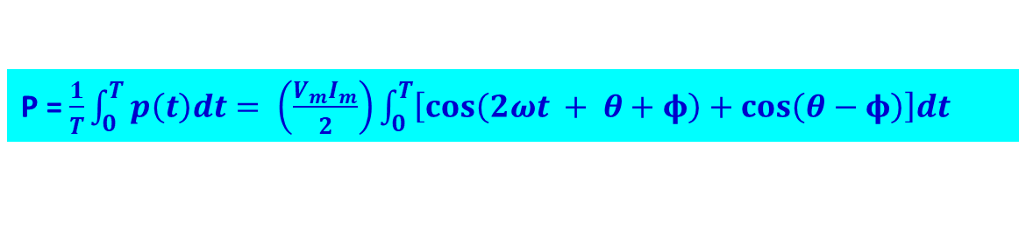
POWER COMPUTATION FOR SINUSOIDAL AC CIRCUIT
The instantaneous Power is expressed as
$p\left(t\right)=v\left(t\right)i\left(t\right)=\left[V_{m}\cos\left(ωt +θ\right)\right]\left[I_{m}\cos\left(ω+ϕ\right)\right]$
Using the trigonometric identity gives
$\left(\cos{A}\right)\left(\cos{B}\right)= \frac{1}{2}\left[\cos\left(A+B\right)+\cos\left(A−B\right)\right]$
$p\left(t\right)= \left(\frac{V_{m}I_{m}}{2}\right)\left[\cos\left(2ωt+θ+ϕ\right)+\cos\left(θ−ϕ\right)\right]$
Average Power is
Note : Since the first term in the integration is cosine function, the integral over one period is zero. The second term in the integration is the constant $\cos\left(θ−ϕ\right)$, which has an average value of $\cos\left(θ−ϕ\right)$
P = $\frac{1}{T}\int_{0}^{T}{p\left(t\right)dt= \left(\frac{V_{m}I_{m}}{2}\right)\int_{0}^{T}{\left[\cos\left(2ωt + θ+φ\right)+\cos\left(θ−φ\right)\right]dt} }$

Slide 24
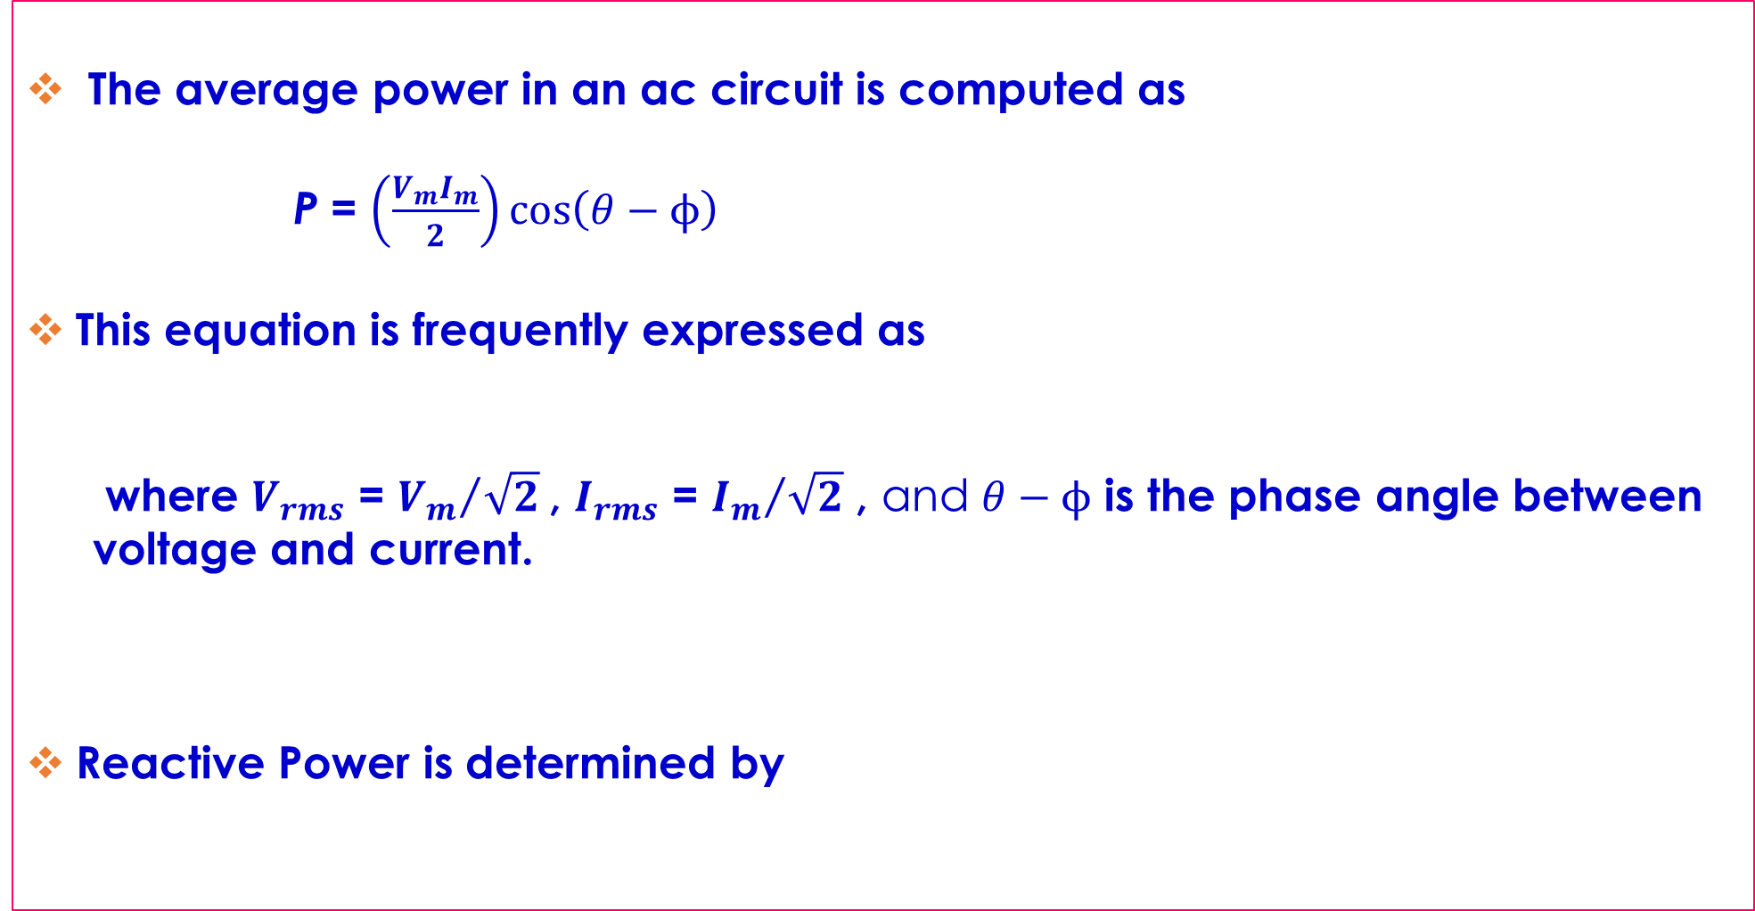



POWER COMPUTATION FOR SINUSOIDAL AC CIRCUIT
The average power in an ac circuit is computed as
P = $\left(\frac{V_{m}I_{m}}{2}\right)\cos\left(θ−ϕ\right)$
This equation is frequently expressed as
where $V_{rms}$ = ${V_{m}}/{\sqrt{2}}$, $I_{rms}$ = ${I_{m}}/{\sqrt{2}}$ , and $θ−ϕ$ is the phase angle between voltage and current.
Reactive Power is determined by
P = $V_{rms}I_{rms}\cos\left(θ−φ\right)$
Pf = $\cos\left(θ−φ\right)$
Q = $V_{rms}I_{rms}\sin\left(θ−φ\right)$

Slide 25

POWER COMPUTATION FOR SINUSOIDAL AC CIRCUIT
Apparent Power is computed as
S = $\sqrt{P^{2}+Q^{2}}$

Slide 26
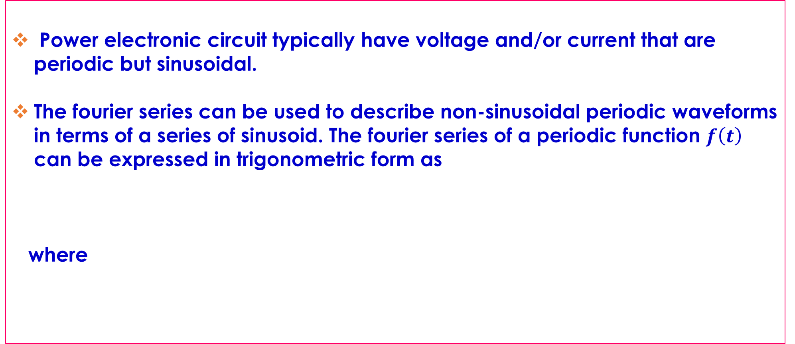

POWER COMPUTATION FOR NONSINUSOIDAL PERIODIC WAVEFORMS
Power electronic circuit typically have voltage and/or current that are periodic but sinusoidal.
The fourier series can be used to describe non-sinusoidal periodic waveforms in terms of a series of sinusoid. The fourier series of a periodic function $f\left(t\right)$ can be expressed in trigonometric form as
where
$f(t)$ = $a_{0}+\sum_{n=1}^{∞}{\left[a_{n}\cos\left(nω_{0}t\right)+b_{n}\sin\left(nω_{0}t\right)\right]}$
$a_{0}$=$\frac{1}{T}\int_{{−T}/2}^{T/2}{f\left(t\right)dt}$

Slide 27
POWER COMPUTATION FOR NONSINUSOIDAL PERIODIC WAVEFORMS
Sines and Cosines with the same frequency can merged into a single sinusoid, providing an alternative representation for a Fourier series
where
$a_{n}$ = $\frac{2}{T}\int_{{−T}/2}^{T/2}{f\left(t\right)\cos\left(nω_{0}t\right)dt}$
$b_{n}$ = $\frac{2}{T}\int_{{−T}/2}^{T/2}{f(t)\sin\left(nω_{0}t\right)dt}$
$f(t)$ = $a_{0}$ $+$ $\sum_{n=1}^{∞}{C_{n}}\cos\left(nω_{0}t+θ_{n}\right)$
$C_{n}$ = $\sqrt{a_{n}^{2}+b_{n}^{2}}$ and $θ_{n}$ = $\tan^{−1}\left(\frac{{−b}_{n}}{a_{n}}\right)$

Slide 28
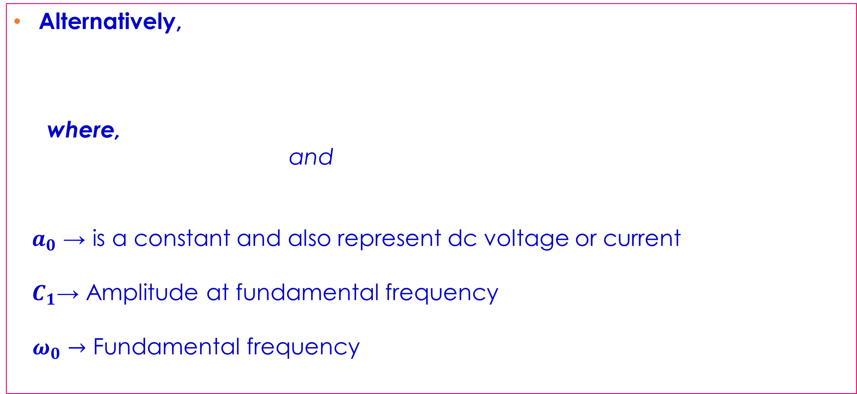


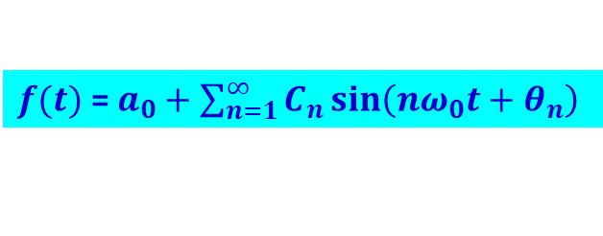
POWER COMPUTATION FOR NONSINUSOIDAL PERIODIC WAVEFORMS
Alternatively,
where,
and
$a_{0}$ → is a constant and also represent dc voltage or current
$C_{1}$→ Amplitude at fundamental frequency
$ω_{0}→$ Fundamental frequency
$f(t)$ = $a_{0}+\sum_{n=1}^{∞}{C_{n}\sin\left(nω_{0}t+θ_{n}\right)}$
$C_{n}$ = $\sqrt{a_{n}^{2}+b_{n}^{2}}$
$θ_{n}$ = $\tan^{−1}\left(\frac{a_{n}}{b_{n}}\right)$

Slide 29
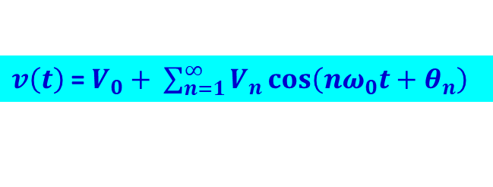
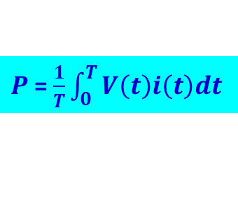
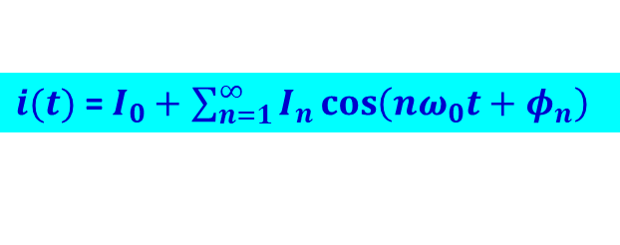
POWER COMPUTATION FOR NONSINUSOIDAL PERIODIC WAVEFORMS
Periodic voltage and current waveform represented by Fourier series:
Average Power is computed as
Note : The average of voltage and current products of different frequencies is ZERO.
$v\left(t\right)$ = $V_{0}+ \sum_{n=1}^{∞}{V_{n}\cos\left(nω_{0}t+θ_{n}\right)}$
$i(t)$ = $I_{0}+$ $\sum_{n=1}^{∞}{I_{n}}\cos\left(nω_{0}t+φ_{n}\right)$
$P$= $\frac{1}{T}\int_{0}^{T}{V\left(t\right)i\left(t\right)dt}$

Slide 30
POWER COMPUTATION FOR NONSINUSOIDAL PERIODIC WAVEFORMS
Consequently, average power for nonsinusoidal periodic voltage and current waveform is
    or
$P$ = $\sum_{n=0}^{∞}{P_{n}}$ = $V_{0}I_{0}+ \sum_{n=1}^{∞}{V_{n,rms}}I_{n,rms}\cos\left(θ_{n}−φ_{n}\right)$
$P$ = $V_{0}I_{0}+ \sum_{n=1}^{∞}{\left(\frac{V_{n,ma×}I_{n,ma×}}{2}\right)}\cos\left(θ_{n}−φ_{n}\right)$

Slide 31
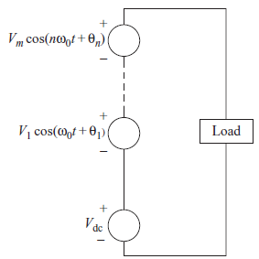
POWER COMPUTATION FOR NONSINUSOIDAL SOURCE AND LINEAR LOAD
If a nonsinusoidal periodic voltage is applied to a load that is a combination of linear element, the power absorbed by the load can be determined by using superposition.
A nonsinusoidal periodic voltage is equivalent to the series combination of the Fourier series voltage.
Equivalent circuit for Fourier Analysis

Slide 32
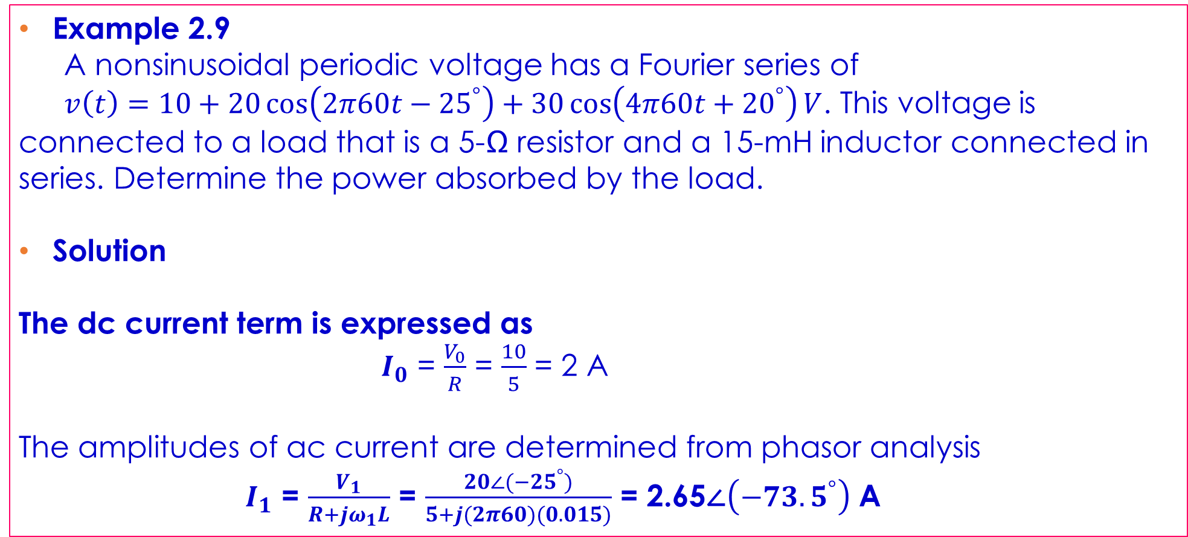
POWER COMPUTATION FOR NONSINUSOIDAL SOURCE AND LINEAR LOAD
Example 2.9
A nonsinusoidal periodic voltage has a Fourier series of
$v\left(t\right)=10+20\cos\left(2π60t−{25}^{°}\right)+30\cos\left(4π60t+{20}^{°}\right)V$. This voltage is connected to a load that is a 5-Ω resistor and a 15-mH inductor connected in series. Determine the power absorbed by the load.
Solution
The dc current term is expressed as
$I_{0}$ = $\frac{V_{0}}{R}$ = $\frac{10}{5}$ = 2 A
The amplitudes of ac current are determined from phasor analysis
$I_{1}$ = $\frac{V_{1}}{R+jω_{1}L}$ = $\frac{20∠(−{25}^{°})}{5+j(2π60)(0.015)}$ = 2.65∠$\left(−{73.5}^{°}\right)$ A

Slide 33
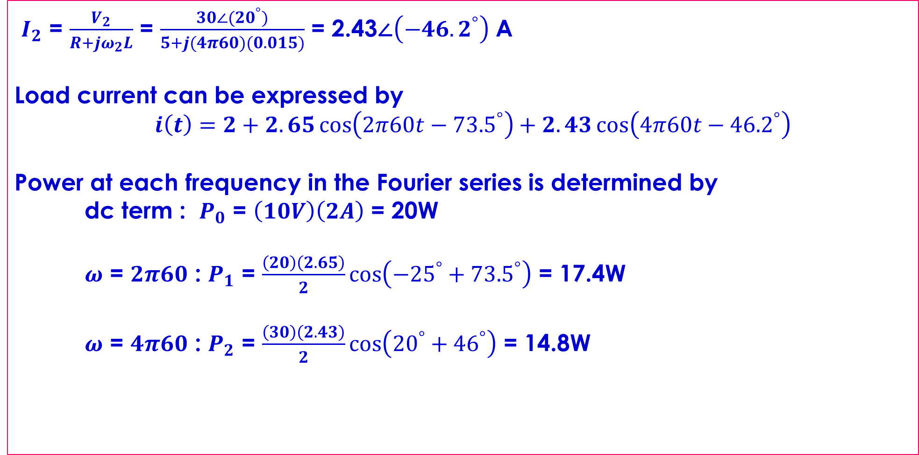
POWER COMPUTATION FOR NONSINUSOIDAL SOURCE AND LINEAR LOAD
$I_{2}$ = $\frac{V_{2}}{R+jω_{2}L}$ = $\frac{30∠({20}^{°})}{5+j(4π60)(0.015)}$ = 2.43∠$\left(−{46.2}^{°}\right)$ A
Load current can be expressed by
$i\left(t\right)=2+2.65\cos\left(2π60t−{73.5}^{°}\right)+2.43\cos\left(4π60t−{46.2}^{°}\right)$
Power at each frequency in the Fourier series is determined by
dc term : $P_{0}$ = $\left(10V\right)\left(2A\right)$ = 20W
$ω$ = $2π60$ : $P_{1}$ = $\frac{\left(20\right)\left(2.65\right)}{2}\cos\left(−{25}^{°}+{73.5}^{°}\right)$ = 17.4W
$ω$ = $4π60$ : $P_{2}$ = $\frac{\left(30\right)\left(2.43\right)}{2}\cos\left({20}^{°}+{46}^{°}\right)$ = 14.8W

Slide 34
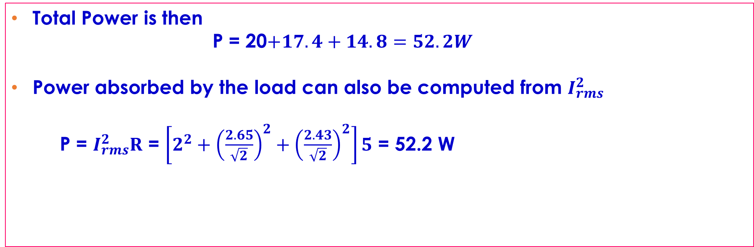
POWER COMPUTATION FOR NONSINUSOIDAL SOURCE AND LINEAR LOAD
Total Power is then
P = 20$+17.4+14.8=52.2W$
Power absorbed by the load can also be computed from $I_{rms}^{2}$
P = $I_{rms}^{2}R$ = $\left[2^{2}+{\left(\frac{2.65}{\sqrt{2}}\right)}^{2}+{\left(\frac{2.43}{\sqrt{2}}\right)}^{2}\right]5$ = 52.2 W

Slide 35





POWER COMPUTATION FOR SINUSOIDAL SOURCE AND LINEAR LOAD
Voltage sinusoid is given by
Current sinusoid is given
Average Power absorbed by load is given by
= (0)$\left(I_{0}\right)+\left(\frac{V_{1}I_{1}}{2}\right)\cos\left(θ_{1}−φ_{1}\right)+\sum_{n=1}^{∞}{\frac{\left(0\right)\left(I_{n,ma×}\right)}{2}}\cos\left(θ_{n}−φ_{n}\right)$
NB: Note that only nonzero power term is at the frequency of the applied voltage
$v(t)$ = $V_{1}\sin\left(ω_{0}t+θ_{1}\right)$
$i(t)$ = $I_{0}+\sum_{n=1}^{∞}{I_{n}\sin\left(nω_{0}t+φ_{n}\right)}$
$P$ = $V_{0}I_{0}+\sum_{n=1}^{∞}{\left(\frac{V_{n,ma×}I_{n,ma×}}{2}\right)\cos\left(θ_{n}−φ_{n}\right)}$
P = $\frac{V_{1}I_{1}}{2}\cos\left(θ_{1}−φ_{1}\right)$ = $V_{1,rms}I_{1,rms}\cos\left(θ_{1}−φ_{1}\right)$

Slide 36




POWER COMPUTATION FOR SINUSOIDAL SOURCE AND LINEAR LOAD
The power factor of the load is computed
RMS Current is expressed as
Note: For a sinusoidal voltage and a sinusoidal current, pf = $\cos\left(θ_{1}−φ_{1}\right)$
Pf = $\frac{P}{S}$ = $\frac{P}{V_{rms}I_{rms}}$
Pf = $\frac{V_{1,rms}I_{1,rms}\cos\left(θ_{1}−φ_{1}\right)}{V_{1,rms}I_{rms}}$ = $\left(\frac{I_{1,rms}}{I_{rms}}\right)\cos\left(θ_{1}−φ_{1}\right)$
$I_{rms}$ = $\sqrt{\sum_{n=0}^{∞}{I_{n,rms}^{2}}}$ = $\sqrt{I_{0}^{2}+\sum_{n=1}^{∞}{{\left(\frac{I_{n}}{\sqrt{2}}\right)}^{2}}}$

Slide 37



POWER COMPUTATION FOR SINUSOIDAL SOURCE AND LINEAR LOAD
Distortion Factor is determined by
Power factor can also be expressed as
Total harmonic distortion (THD) is used to quantify the nonsinusoidal property of waveform. THD is the ratio of the rms value of all the nonfundamental frequency terms of the rms value of the fundamental frequency term.
DF = $\frac{I_{1,rms}}{I_{rms}}$
Pf = $\left[\cos\left(θ_{1}−φ_{1}\right)\right]$DF
THD = $\sqrt{\frac{\sum_{n≠1}{I_{n,rms}^{2}}}{I_{1,rms}^{2}}}$ = $\sqrt{\frac{I_{rms}^{2}−I_{1,rms}^{2}}{I_{1,rms}^{2}}}$

Slide 38


POWER COMPUTATION FOR SINUSOIDAL SOURCE AND LINEAR LOAD
THD is often applied in situations where dc term is zero in which case,
Total Harmonic Distortion (THD) can be expressed as
Distortion Factor is expressed as
THD = $\frac{\sqrt{\sum_{n=2}^{∞}{I_{n}^{2}}}}{I_{1}}$
DF = $\sqrt{\frac{1}{1+{\left(THD\right)}^{2}}}$

Slide 39

POWER COMPUTATION FOR SINUSOIDAL SOURCE AND LINEAR LOAD
Example 2-10
A sinusoidal voltage source of $v(t)$ = 100$\cos\left(377t\right)V$ is applied to a nonlinear load, resulting in a nonsinusoidal current which is expressed in Fourier series form as
$i\left(t\right)$ = 8$+$15$\cos\left(377t+{30}^{°}\right)+6\cos\left[2\left(377\right)t+{45}^{°}\right]+2\cos\left[3\left(377\right)t+{60}^{°}\right]$
Determine (a) the power absorbed by the load, (b) the power factor of the load (c) the distortion factor of the load current, (d) the total harmonic distortion of the load current.
Solution
(a) Power absorbed by the load is determined by
P = $\left(0\right)\left(8\right)+\left(\frac{100}{\sqrt{2}}\right)\left(\frac{15}{\sqrt{2}}\right)\cos\left({30}^{°}\right)+\left(0\right)\left(\frac{6}{\sqrt{2}}\right)\cos{{45}^{°}}+\left(0\right)\left(\frac{2}{\sqrt{2}}\right)\cos{{60}^{°}}$

Slide 40

POWER COMPUTATION FOR SINUSOIDAL SOURCE AND LINEAR LOAD
P =$\left(\frac{100}{\sqrt{2}}\right)\left(\frac{15}{\sqrt{2}}\right)\cos{{30}^{°}}$ = 650 W
(b) The rms voltage is
$V_{rms}$ = $\frac{100}{\sqrt{2}}$ = 70.7 V
The rms current is computed as
$I_{rms}$ = $\sqrt{8^{2}+{\left(\frac{15}{\sqrt{2}}\right)}^{2}+{\left(\frac{6}{\sqrt{2}}\right)}^{2}+{\left(\frac{2}{\sqrt{2}}\right)}^{2}}$ = 14.0 A
The Power factor is expressed as
pf = $\frac{P}{S}$ = $\frac{P}{V_{rms}I_{rms}}$ = $\frac{650}{\left(70.7\right)\left(14.0\right)}$ = 0.66

Slide 41

POWER COMPUTATION FOR SINUSOIDAL SOURCE AND LINEAR LOAD
Alternatively, power factor can be computed as
pf = $\frac{I_{1,rms}\cos\left(θ_{1}−φ_{1}\right)}{I_{rms}}$ = $\frac{\left(\frac{5}{\sqrt{2}}\right)\cos\left(0−{30}^{°}\right)}{14.0}$ = 0.66
(c) Distortion Factor is determined by
DF = $\frac{I_{1,rms}}{I_{rms}}$ = $\frac{\frac{15}{\sqrt{2}}}{14.0}$ = 0.76
(d) Total harmonic distortion of the load current is determined by
THD = $\sqrt{\frac{I_{rms}^{2}−I_{1,rms}^{2}}{I_{1,rms}^{2}}}$ = $\sqrt{\frac{{14}^{2}−{\left(\frac{15}{\sqrt{2}}\right)}^{2}}{{\left(\frac{15}{\sqrt{2}}\right)}^{2}}}$ = 0.86 = 86%

